Slide 1
One family seminar on family law in ireland
2nd July 2020

Slide 2
HEADLINES
Child care and family law cases – a false distinction and not a reflection of real lives or the way people are living their lives;
Family law cases are the poor relation compared to child care cases and family law is the poor relation compared to other branches of the law. They need to shift from the margin to the mainstream. Although reform is in the Programme for Government, change still has to be fought for with great attention on managing the transitions needed;
Thousands of adults in Ireland bear the invisible scars of conflicts at home when they were growing up – the learning about how to construct a new family law system lies in their experience;
Getting the legislation and regulations right is crucial as many changes will be controversial – always difficult for a coalition Government;
Ireland has a great opportunity now to learn the lessons, good and bad, from the same developments in other countries over the last decade and to avoid obvious pitfalls – that were not obvious in advance;
Assuming here is no extra money, existing budgets need to be re-directed as a key element of a 5-10 year change programme;
Public health messaging and expansion of dispute resolution services such as helplines are important first steps.

Slide 3
Cafcass: what, where, when and why?
Cafcass is the largest statutory voice of the child service in the world, 100% funded by Government and sponsored by the Ministry of Justice
Its remit is court-based, plus limited prevention work at the edge of court;
Formed in 2001 from 117 predecessor organisations to cover England and Wales, England-only from 2005;
Cafcass employs the most social workers in Europe;
140,000 children (cases) a year, 60% of which are family law cases;
Over 50% of family law applications feature child protection or serious welfare concerns such as domestic abuse, mental health concerns or parental alienation;
Like paediatric echocardiographers who film a child’s heart from numerous angles, Cafcass practitioners have to do the same with the child’s heart from numerous emotional angles;
Family law cases are ‘emotional labour’. Few starting out in this work realise how highly charged and challenging many cases are today. Cafcass and senior judges have championed the needs of children in family law cases to build a system – without a system, cases will be handled inconsistently and often chaotically;
For a child, a family law dispute can have an adverse lifetime consequence, hence the importance of dispute resolution.

Slide 4
Family law cases overview
Parent makes C100 application to the court, seeking a Child Arrangement Order or a C79 application for enforcement;
Safeguarding report written for court in every case;
Most First Hearings are attended by a Cafcass practitioner;
66% of cases resolve at First Hearing (after 4 to 6 weeks);
34% of cases require a targeted intervention by Cafcass
Reductions in legal representation since 2013 mean a high percentage of applicants represent themselves which has changed the roles of judges, court staff and Cafcass practitioners to be much more hands-on e.g. motivational judging

Slide 5
The English family justice system - ten years in the making – the key transitions
Expanding the numbers and skills of all family justice professionals – developing a specialism;
Installing a governance structure – a national Family Justice Board chaired by Ministers (Justice and Education), 42 local Family Justice Boards and a Family Justice Young People’s Board which I set up in 2006 and which remains influential;
From 100 page court reports to a 5-10 page child impact analysis;
From 117 local court cultures to a national family justice system identity;
Matching service provision to the 30/45/20/5 rule in family law cases, especially as much stronger community dispute resolution infrastructure in local areas;
Family law issues are converging in most countries just as politics is diverging– we can learn from one another through policy alliances;
Remote working offers some affordable solutions and is a key workstream for the future.

Slide 6
Building blocks for an integrated family court
Systems – in England we have the Child Arrangements Programme, with a further re-design imminent. We built safeguarding into the Programme so it was considered in every case and also created the parameters for reducing case duration, which translated meant ‘limbo for children’. Strong systems are the only way to achieve a consistent level of service and decision-making across a country;
Getting the court service right. This includes digitisation and job roles e.g., we are currently looking at Vulnerable Persons Liaison Officers (VLPO’s) in court to support vulnerable people, with a presumption of automatic eligibility for special measures in domestic abuse cases;
Working with campaigners and pressure groups. It is crucial to have policy discussions routinely with groups representing mothers, fathers, grandparents etc;
The devil is in the detail. Get the small things sorted e.g., disclosure requirements.

Slide 7
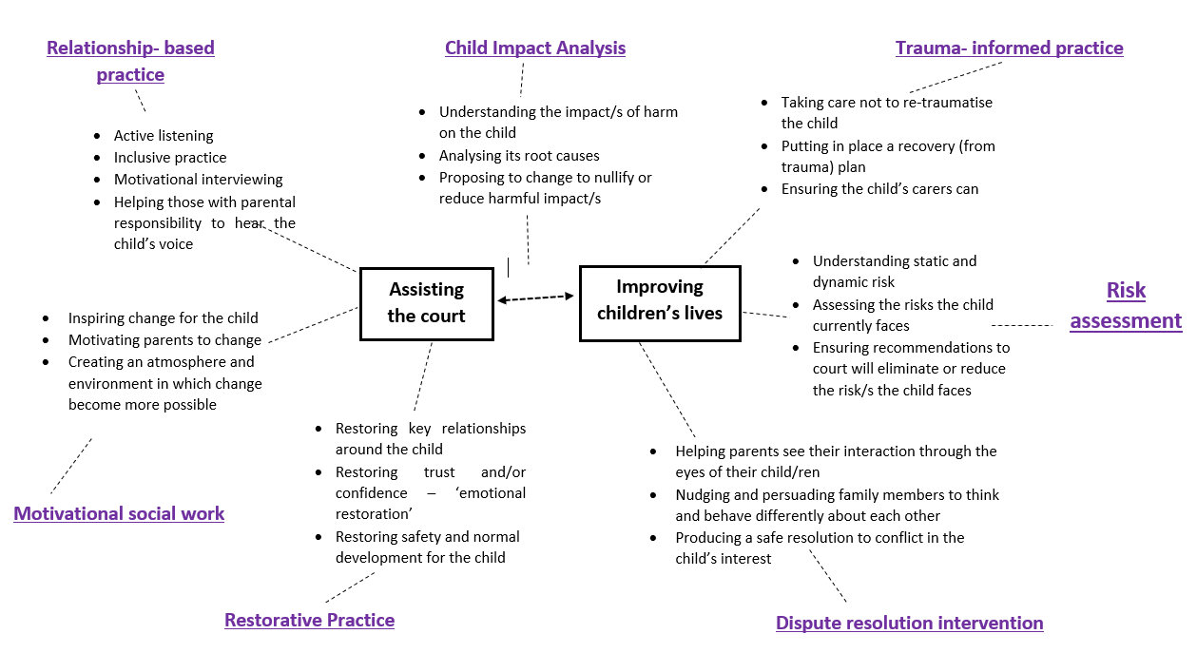
The eclectic model of social work practice in Cafcass

Slide 8
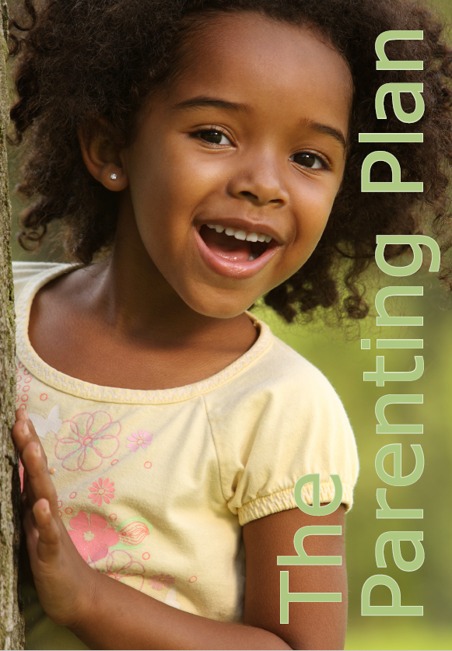
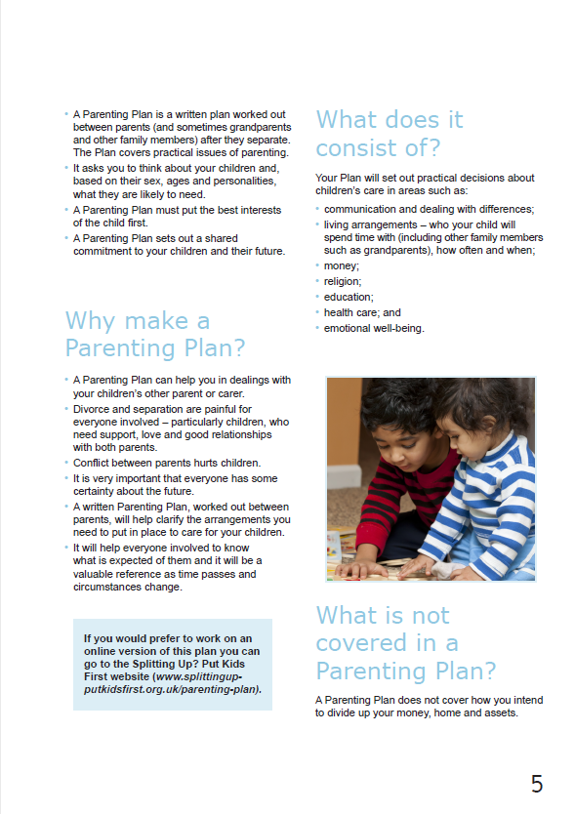

Slide 9
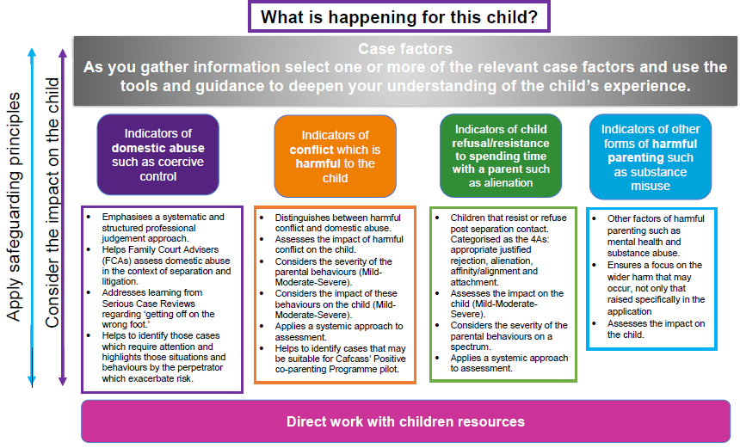
Child Impact Assessment Framework (CIAF)
https://www.cafcass.gov.uk/grown-ups/professionals/ciaf

Slide 10
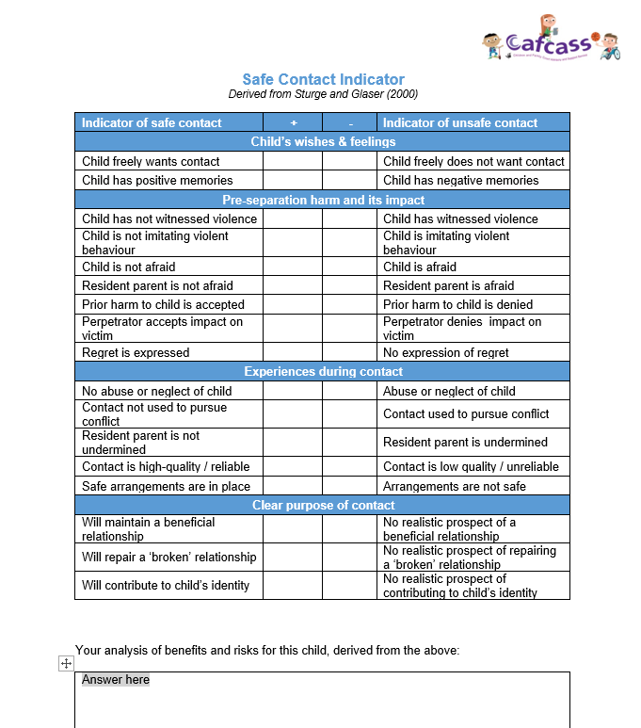
Safe Contact
Indicator

Slide 11
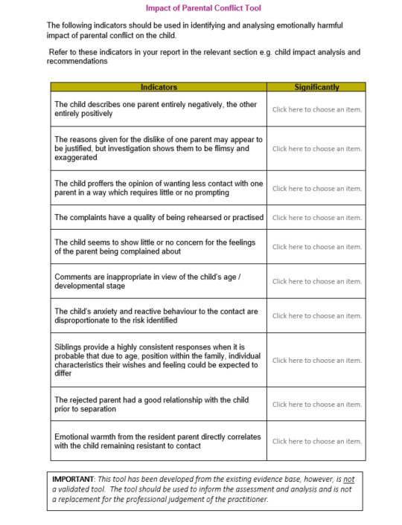
Impact of
Parental Conflict
Tool

Slide 12
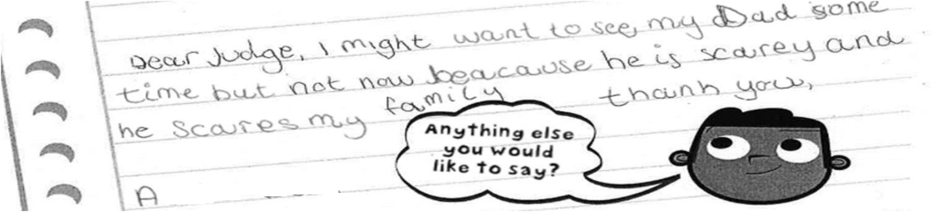
The child’s words inside a court report
When I asked A what memories he had from when he and his parents all lived together in Devon he initially said none. His demeanour changed from upbeat and engaging to fidgety and looking away.
I paused for a moment to let A gather his thoughts when he added “well, one time they argued in the garden and Dad kicked the BBQ over”. A said his grandfather ushered him inside (suggesting this was some kind of family event) but that he could still hear shouting from where he was sat in the living room. A recalled his mother crying and said she went and “hided in her bedroom”.
A was clearly frightened during this incident and although well intended, being taken into the living room out of the way was not enough to protect him from the harmful effects of this altercation. A’s description of this episode goes some way in supporting his ‘letter to the judge’ copied below:
When I asked A what memories he had from when he and his parents all lived together in Devon he initially said none. His demeanour changed from upbeat and engaging to fidgety and looking away.
I paused for a moment to let A gather his thoughts when he added “well, one time they argued in the garden and Dad kicked the BBQ over”. A said his grandfather ushered him inside (suggesting this was some kind of family event) but that he could still hear shouting from where he was sat in the living room. A recalled his mother crying and said she went and “hided in her bedroom”.
A was clearly frightened during this incident and although well intended, being taken into the living room out of the way was not enough to protect him from the harmful effects of this altercation. A’s description of this episode goes some way in supporting his ‘letter to the judge’ copied below:

Slide 13
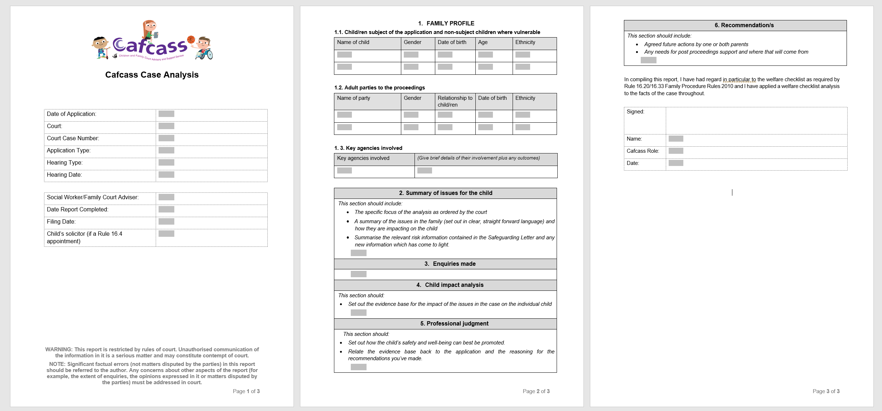
Cafcass Case Analysis Template

Slide 14
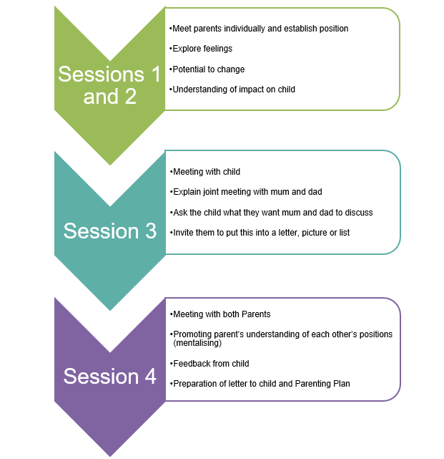
We recognise that our statutory role
and the court process may not always
help to resolve underlying issues for the
children and families we work with. We
have therefore taken proactive steps to
develop some programmes to assist. An
example of this is the Cafcass Positive
co-Parenting Programme.
Cafcass Positive co-Parenting Programme
(CPPP):
The CPPP is a way of working which
draws on psychological and systemic
intervention aiming at reducing harmful
conflict and emotional harm to children
through a solution focused approach.
The programme is a time-limited, four
stage intervention that can be applied in
the toughest 5% of cases,
Each service area has dedicated staff
who are trained in the model.
The CPPP suitability tool helps practitioners
to identify suitable cases for the programme.

